Slide 1


Regression

Slide 2
Correlation and Simple Linear Regression

Slide 3
The Sample Covariance
The sample covariance measures the strength of the linear relationship between two variables (called bivariate data)
The sample covariance:
Only concerned with the strength of the relationship
No causal effect is implied
Depends on the unit of measurement used for X and Y

Slide 4
Interpreting Covariance
Covariance between two random variables:
cov(X,Y) > 0 X and Y tend to move in the same direction
cov(X,Y) < 0 X and Y tend to move in opposite directions
cov(X,Y) = 0 X and Y are independent

Slide 5
Coefficient of Correlation
Measures the relative strength of the linear relationship between two variables
Sample coefficient of correlation:
where

Slide 6
Features of Correlation Coefficient, r
Unit free
Ranges between –1 and 1
The closer to –1, the stronger the negative linear relationship
The closer to 1, the stronger the positive linear relationship
The closer to 0, the weaker the linear relationship

Slide 7
Scatter Plots of Data with Various Correlation Coefficients
Y
Y
Y
X
X
X
r = -1
r = -.6
r = 0
Y
Y
Y
X
X
X
r = +1
r = +.3
r = 0

Slide 8
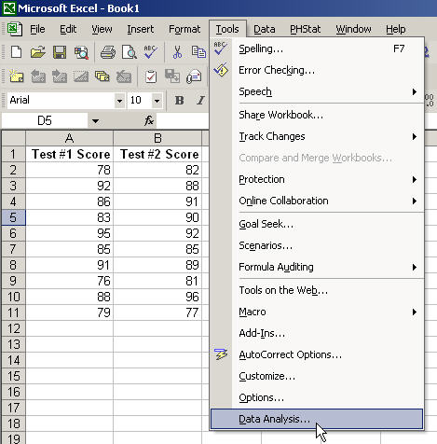
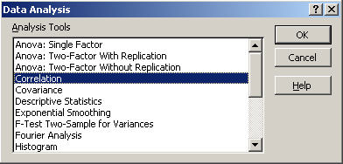
Using Excel to Find the Correlation Coefficient
Select
Tools/Data Analysis
Choose Correlation from the selection menu
Click OK . . .

Slide 9
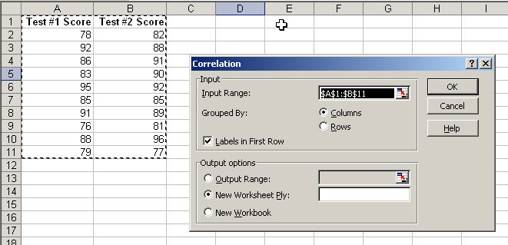

Using Excel to Find the Correlation Coefficient
(continued)
Input data range and select appropriate options
Click OK to get output

Slide 10
Interpreting the Result
r = .733
There is a relatively
strong positive linear
relationship between
test score #1
and test score #2
Students who scored high on the first test tended to score high on second test, and students who scored low on the first test tended to score low on the second test

Slide 11
Correlation vs. Regression
A scatter diagram can be used to show the relationship between two variables
Correlation analysis is used to measure strength of the association (linear relationship) between two variables
Correlation is only concerned with strength of the relationship
No causal effect is implied with correlation
Scatter diagrams were first presented in Ch. 2

Slide 12
Introduction to Regression Analysis
Regression analysis is used to:
Predict the value of a dependent variable based on the value of at least one independent variable
Explain the impact of changes in an independent variable on the dependent variable
Dependent variable: the variable we wish to predict
or explain
Independent variable: the variable used to explain the dependent variable

Slide 13
Simple Linear Regression Model
Only one independent variable, X
Relationship between X and Y is described by a linear function
Changes in Y are assumed to be caused by changes in X

Slide 14
Simple Linear Regression Model
Population Slope Coefficient
Population Y intercept
Independent Variable
Dependent Variable
Linear component

Slide 15
Y = β₁ + β₂X + ϵ
β₁ is the intercept and β₂ is the slope.
Collectively, they are called regression coefficients.
ϵ is the error term, the part of Y the regression model is unable to explain.

Slide 16
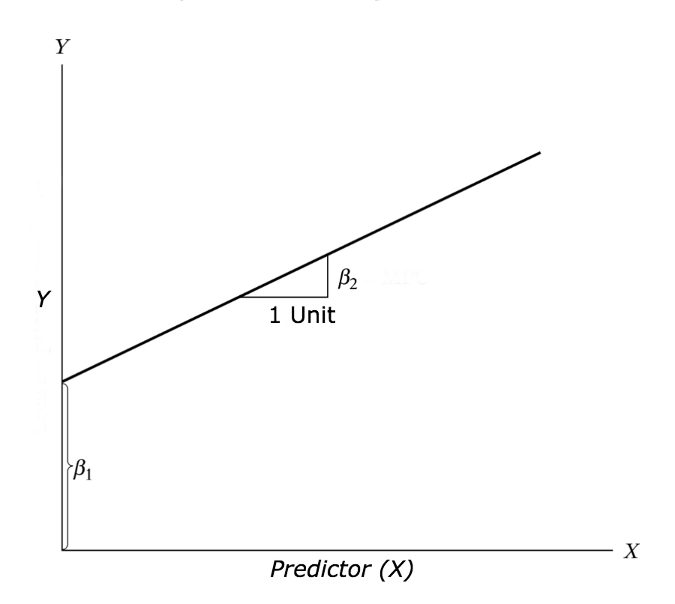

Slide 17
Simple Linear Regression Equation (Prediction Line)
The simple linear regression equation provides an estimate of the population regression line
Estimated (or predicted) Y value for observation i
Estimate of the regression intercept
Estimate of the regression slope
Value of X for observation i

Slide 18
Least Squares Method
b₀ and b₁ are obtained by finding the values of b₀ and b₁ that minimize the sum of the squared differences between Y and :

Slide 19
Finding the Least Squares Equation
The coefficients b₀ and b₁ , and other regression results in this chapter, will be found using Excel or Minitab
Formulas are shown in the text for those who are interested

Slide 20
Interpretation of the Slope and the Intercept
b₀ is the estimated average value of Y when the value of X is zero
b₁ is the estimated change in the average value of Y as a result of a one-unit change in X

Slide 21

Simple Linear Regression Example
A real estate agent wishes to examine the relationship between the selling price of a home and its size (measured in square feet)
A random sample of 10 houses is selected
Dependent variable (Y) = house price in $1000s
Independent variable (X) = square feet

Slide 22
Sample Data for House Price Model
House Price in $1000s (Y) | Square Feet (X)
245 | 1400
312 | 1600
279 | 1700
308 | 1875
199 | 1100
219 | 1550
405 | 2350
324 | 2450
319 | 1425
255 | 1700

Slide 23
Graphical Presentation
House price model: scatter plot

Slide 24
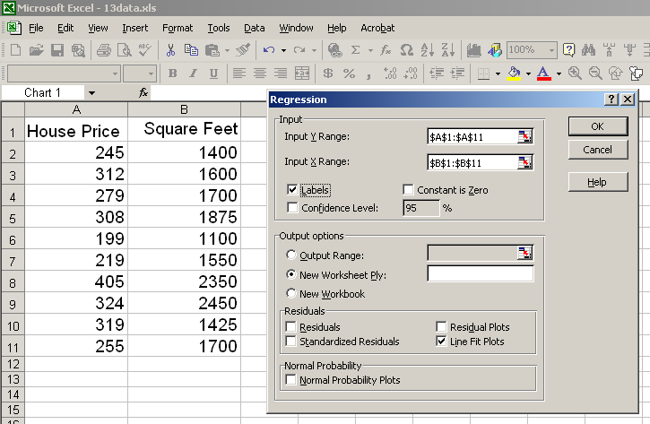
Regression Using Excel
Tools / Data Analysis / Regression

Slide 25
Excel Output
Regression Statistics
Multiple R | 0.76211
R Square | 0.58082
Adjusted R Square | 0.52842
Standard Error | 41.33032
Observations | 10
ANOVA | df | SS | MS | F | Significance F
Regression | 1 | 18934.9348 | 18934.9348 | 11.0848 | 0.01039
Residual | 8 | 13665.5652 | 1708.1957
Total | 9 | 32600.5000
 | Coefficients | Standard Error | t Stat | P-value | Lower 95% | Upper 95%
Intercept | 98.24833 | 58.03348 | 1.69296 | 0.12892 | -35.57720 | 232.07386
Square Feet | 0.10977 | 0.03297 | 3.32938 | 0.01039 | 0.03374 | 0.18580
The regression equation is:

Slide 26
Graphical Presentation
House price model: scatter plot and regression line
Slope
= 0.10977
Intercept
= 98.248

Slide 27
Interpretation of the Intercept, b₀
b₀ is the estimated average value of Y when the value of X is zero (if X = 0 is in the range of observed X values)
Here, no houses had 0 square feet, so b₀ = 98.24833 just indicates that, for houses within the range of sizes observed, $98,248.33 is the portion of the house price not explained by square feet

Slide 28
Interpretation of the Slope Coefficient, b₁
b₁ measures the estimated change in the average value of Y as a result of a one-unit change in X
Here, b₁ = .10977 tells us that the average value of a house increases by .10977($1000) = $109.77, on average, for each additional one square foot of size

Slide 29
Predictions using Regression Analysis
Predict the price for a house with 2000 square feet:
The predicted price for a house with 2000 square feet is 317.85($1,000s) = $317,850

Slide 30
Coefficient of Determination, r²
The coefficient of determination is the portion of the total variation in the dependent variable that is explained by variation in the independent variable
The coefficient of determination is also called r-squared and is denoted as r²
note:

Slide 33
Example Problem
cars
head(cars)

Slide 34
Before building the regression model
To analyse and understand the variables.
Notes:
The graphical analysis and correlation study will help with this.

Slide 35
Graphical Analysis
To predict Distance (dist) by establishing a statistically significant linear relationship with Speed (speed).
Scatter plot: Visualize the linear relationship between the predictor and response
Box plot: To spot any outlier observations in the variable. Having outliers in your predictor can drastically affect the predictions as they can easily affect the direction/slope of the line of best fit.
Density plot: To see the distribution of the predictor variable. Ideally, a close to normal distribution (a bell shaped curve), without being skewed to the left or right is preferred. Let us see how to make each one of them.

Slide 36
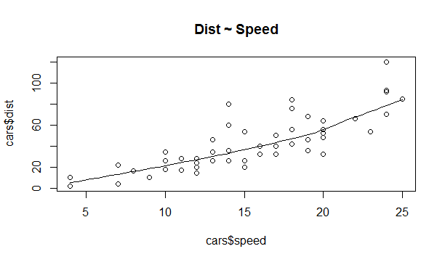
Scatter Plot
scatter.smooth(x=cars$speed, y=cars$dist, main="Dist ~ Speed")
Notes:
Scatter plots can help visualize any linear relationships between the dependent (response) variable and independent (predictor) variables. Ideally, if you are having multiple predictor variables, a scatter plot is drawn for each one of them against the response, along with the line of best
The scatter plot along with the smoothing line above suggests a linearly increasing relationship between the ‘dist’ and ‘speed’ variables. This is a good thing, because, one of the underlying assumptions in linear regression is that the relationship between the response and predictor variables is linear and additive.

Slide 37
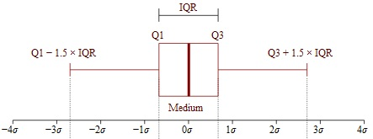
BoxPlot – Check for outliers
Generally, any datapoint that lies outside the 1.5 * interquartile-range (1.5 * IQR) is considered an outlier, where, IQR is calculated as the distance between the 25th percentile and 75th percentile values for that variable.
Notes:
interquartile range (IQR)

Slide 38
par(mfrow=c(1, 2)) # divide graph area in 2 columns
boxplot(cars$speed, main="Speed", sub=paste("Outlier rows: ", boxplot.stats(cars$speed)$out)) # box plot for 'speed'
boxplot(cars$dist, main="Distance", sub=paste("Outlier rows: ", boxplot.stats(cars$dist)$out)) # box plot for 'distance'

Slide 39
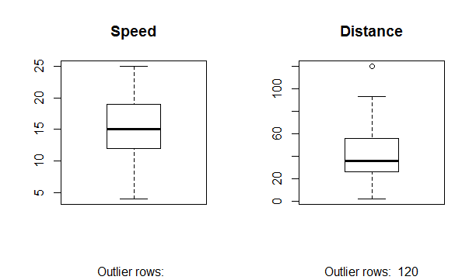

Slide 40
Density plot – Check if the response variable is close to normality
library(e1071)
par(mfrow=c(1, 2)) # divide graph area in 2 columns
plot(density(cars$speed), main="Density Plot: Speed", ylab="Frequency", sub=paste("Skewness:", round(e1071::skewness(cars$speed), 2))) # density plot for 'speed'
polygon(density(cars$speed), col="red")
plot(density(cars$dist), main="Density Plot: Distance", ylab="Frequency", sub=paste("Skewness:", round(e1071::skewness(cars$dist), 2)))
polygon(density(cars$dist), col="red")

Slide 41
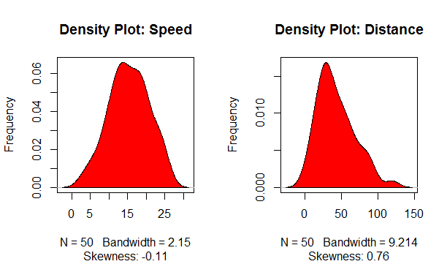

Slide 42
Correlation
Correlation is a statistical measure that suggests the level of linear dependence between two variables, that occur in pair – just like what we have here in speed and dist. Correlation can take values between -1 to +1.
If we observe for every instance where speed increases, the distance also increases along with it, then there is a high positive correlation between them and therefore the correlation between them will be closer to 1.
The opposite is true for an inverse relationship, in which case, the correlation between the variables will be close to -1.

Slide 43
A value closer to 0 suggests a weak relationship between the variables.
A low correlation (-0.2 < x < 0.2) probably suggests that much of variation of the response variable (Y) is unexplained by the predictor (X), in which case, we should probably look for better explanatory variables.
cor(cars$speed, cars$dist)
0.8068949

Slide 44
Build Linear Model
The function used for building linear models is lm().
The lm() function takes in two main arguments, namely:
1. Formula
2. Data.
The data is typically a data.frame and the formula is a object of class formula.
The most common convention is to write out the formula directly in place of the argument

Slide 45
linearMod <- lm(dist ~ speed, data=cars) # build linear regression model on full data
print(linearMod)
#> Call:
#> lm(formula = dist ~ speed, data = cars)
#>
#> Coefficients:
#> (Intercept) speed
#> -17.579 3.932

Slide 46
dist = Intercept + (β ∗ speed) => dist = −17.579 + 3.932∗speed

Slide 47
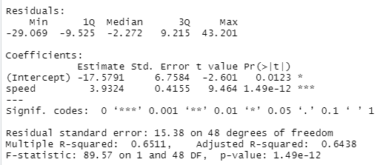
Linear Regression Diagnostics
summary(linearMod)
Notes:
Now the linear model is built and we have a formula that we can use to predict the dist value if a corresponding speed is known. Is this enough to actually use this model? NO! Before using a regression model, you have to ensure that it is statistically significant. How do you ensure this? Lets begin by printing the summary statistics for linearMod.

Slide 48
The p Value: Checking for statistical significance
The model p-Value (bottom last line) and the p-Value of individual predictor variables (extreme right column under ‘Coefficients’).
a linear model to be statistically significant only when both these p-Values are less that the pre-determined statistical significance level, which is ideally 0.05.
This is visually interpreted by the significance stars at the end of the row. The more the stars beside the variable’s p-Value, the more significant the variable.

Slide 49
Null and alternate hypothesis
In Linear Regression, the Null Hypothesis is that the coefficients associated with the variables is equal to zero.
The alternate hypothesis is that the coefficients are not equal to zero (i.e. there exists a relationship between the independent variable in question and the dependent variable).

Slide 50
t-value
A larger t-value indicates that it is less likely that the coefficient is not equal to zero purely by chance. So, higher the t-value, the better.
Pr(>|t|) or p-value is the probability that you get a t-value as high or higher than the observed value when the Null Hypothesis (the β coefficient is equal to zero or that there is no relationship) is true. So if the Pr(>|t|) is low, the coefficients are significant (significantly different from zero). If the Pr(>|t|) is high, the coefficients are not significant.

Slide 52
What this means to us?
When p Value is less than significance level (< 0.05), we can safely reject the null hypothesis that the co-efficient β of the predictor is zero.
In our case, linearMod, both these p-Values are well below the 0.05 threshold, so we can conclude our model is indeed statistically significant.

Slide 53

How to calculate the t Statistic and p-Values?
modelSummary <- summary(linearMod) # capture model summary as an object
modelCoeffs <- modelSummary$coefficients # model coefficients
beta.estimate <- modelCoeffs["speed", "Estimate"] # get beta estimate for speed
std.error <- modelCoeffs["speed", "Std. Error"] # get std.error for speed
t_value <- beta.estimate/std.error # calc t statistic
p_value <- 2*pt(-abs(t_value), df=nrow(cars)-ncol(cars)) # calc p Value
f_statistic <- linearMod$fstatistic[1] # fstatistic
f <- summary(linearMod)$fstatistic # parameters for model p-value calc
model_p <- pf(f[1], f[2], f[3], lower=FALSE)

Slide 54
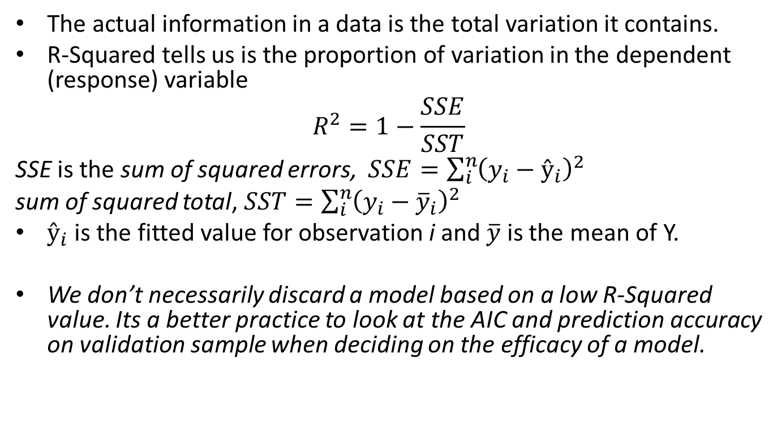
R-Squared and Adj R-Squared
The actual information in a data is the total variation it contains.
R-Squared tells us is the proportion of variation in the dependent (response) variable
$$R^{2}=1−\frac{SSE}{SST}$$
SSE is the sum of squared errors, $SSE=\sum_{i}^{n}{{\left(y_{i}−ŷ_{i}\right)}^{2}}$
sum of squared total, $SST=\sum_{i}^{n}{{\left(y_{i}−{\overline{y}}_{i}\right)}^{2}}$
$ŷ_{i}$ is the fitted value for observation i and $\overline{y}$ is the mean of Y.
We don’t necessarily discard a model based on a low R-Squared value. Its a better practice to look at the AIC and prediction accuracy on validation sample when deciding on the efficacy of a model.

Slide 55
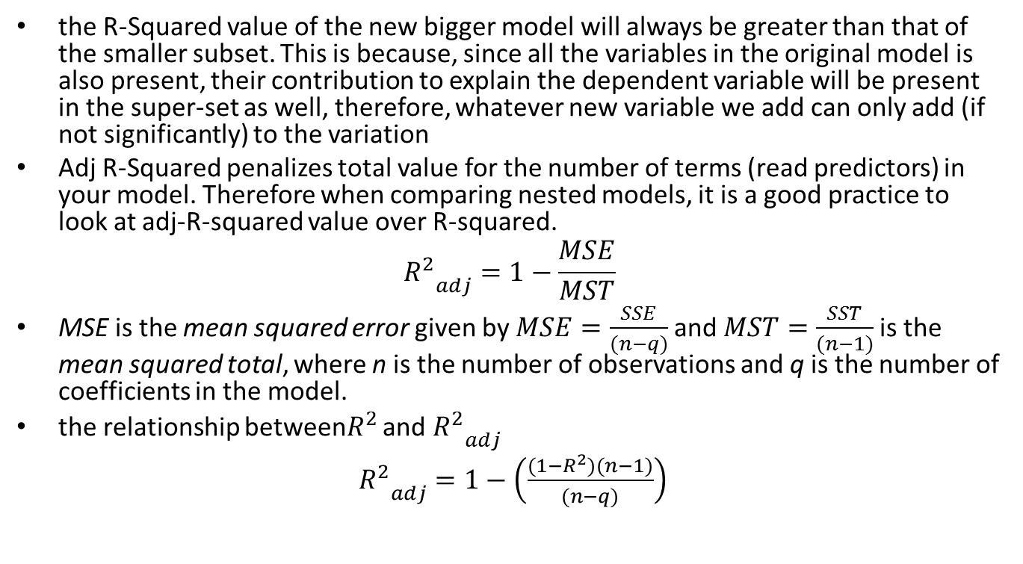
Adjusted R-Squared
the R-Squared value of the new bigger model will always be greater than that of the smaller subset. This is because, since all the variables in the original model is also present, their contribution to explain the dependent variable will be present in the super-set as well, therefore, whatever new variable we add can only add (if not significantly) to the variation
Adj R-Squared penalizes total value for the number of terms (read predictors) in your model. Therefore when comparing nested models, it is a good practice to look at adj-R-squared value over R-squared.
$${R_{}^{2}}_{adj}^{}=1−\frac{MSE}{MST}$$
MSE is the mean squared error given by$MSE=\frac{SSE}{(n−q)}$and $MST=\frac{SST}{(n−1)}$is the mean squared total, where n is the number of observations and q is the number of coefficients in the model.
the relationship between$R_{}^{2}$ and ${R_{}^{2}}_{adj}^{}$
${R_{}^{2}}_{adj}^{}=1−\left(\frac{(1−R_{}^{2})(n−1)}{(n−q)}\right)$

Slide 56
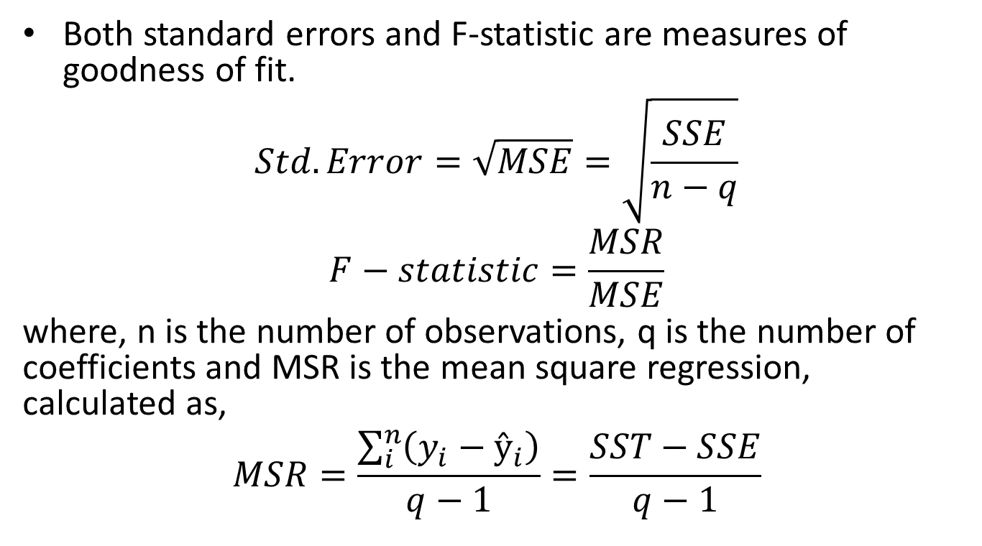
Standard Error and F-Statistic
Both standard errors and F-statistic are measures of goodness of fit.
$$Std.Error=\sqrt{MSE}=\sqrt{\frac{SSE}{n−q}}$$
$$F−statistic=\frac{MSR}{MSE}$$
where, n is the number of observations, q is the number of coefficients and MSR is the mean square regression, calculated as,
$$MSR=\frac{\sum_{i}^{n}{\left(y_{i}−ŷ_{i}\right)}}{q−1}=\frac{SST−SSE}{q−1}$$

Slide 57
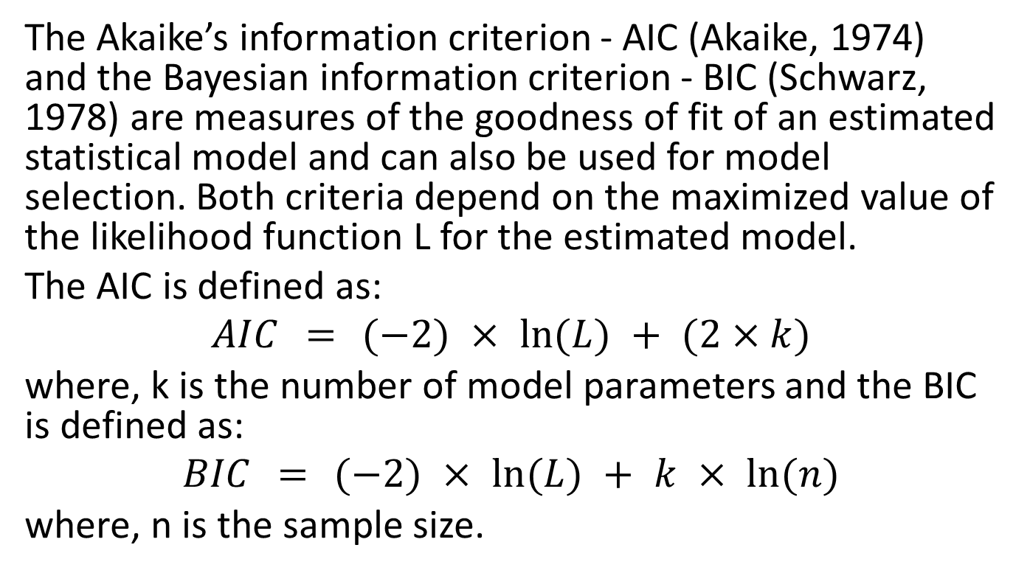
AIC and BIC
The Akaike’s information criterion - AIC (Akaike, 1974) and the Bayesian information criterion - BIC (Schwarz, 1978) are measures of the goodness of fit of an estimated statistical model and can also be used for model selection. Both criteria depend on the maximized value of the likelihood function L for the estimated model.
The AIC is defined as:
$$AIC = (−2) × ln⁡(L) + (2×k)$$
where, k is the number of model parameters and the BIC is defined as:
$$BIC = (−2) × ln⁡(L) + k × ln⁡(n)$$
where, n is the sample size.

Slide 58
For model comparison, the model with the lowest AIC and BIC score is preferred.
AIC(linearMod) # AIC => 419.1569 BIC(linearMod) # BIC => 424.8929

Slide 59
How to know if the model is best fit for your data?
STATISTIC | CRITERION
R-Squared | Higher the better (> 0.70)
Adj R-Squared | Higher the better
F-Statistic | Higher the better
Std. Error | Closer to zero the better
t-statistic | Should be greater 1.96 for p-value to be less than 0.05
AIC | Lower the better
BIC | Lower the better
Mallows cp | Should be close to the number of predictors in model
MAPE (Mean absolute percentage error) | Lower the better
MSE (Mean squared error) | Lower the better
Min_Max Accuracy => mean(min(actual, predicted)/max(actual, predicted)) | Higher the better

Slide 60
Predicting Linear Models
So far we have seen how to build a linear regression model using the whole dataset. If we build it that way, there is no way to tell how the model will perform with new data. So the preferred practice is to split your dataset into a 80:20 sample (training:test), then, build the model on the 80% sample and then use the model thus built to predict the dependent variable on test data.
Doing it this way, we will have the model predicted values for the 20% data (test) as well as the actuals (from the original dataset). By calculating accuracy measures (like min_max accuracy) and error rates (MAPE or MSE), we can find out the prediction accuracy of the model. Now, lets see how to actually do this..

Slide 61
Step 1: Create the training (development) and test (validation) data samples from original data.
# Create Training and Test data –
set.seed(100) # setting seed to reproduce results of random sampling
trainingRowIndex <- sample(1:nrow(cars), 0.8*nrow(cars)) # row indices for training data
trainingData <- cars[trainingRowIndex, ] # model training data
testData <- cars[-trainingRowIndex, ] # test data

Slide 62
Step 2: Develop the model on the training data and use it to predict the distance on test data
# Build the model on training data -
lmMod <- lm(dist ~ speed, data=trainingData) # build the model
distPred <- predict(lmMod, testData) # predict distance

Slide 63
Step 3: Review diagnostic measures.
summary (lmMod) # model summary
#> Call:
#> lm(formula = dist ~ speed, data = trainingData)
#> #> Residuals:
#> Min 1Q Median 3Q Max
#> -23.350 -10.771 -2.137 9.255 42.231
#> #> Coefficients:
#> Estimate Std. Error t value Pr(>|t|)
#> (Intercept) -22.657 7.999 -2.833 0.00735 **
#> speed 4.316 0.487 8.863 8.73e-11 ***
#> ---
#> Signif. codes: 0 '***' 0.001 '**' 0.01 '*' 0.05 '.' 0.1 ' ' 1
#>
#> Residual standard error: 15.84 on 38 degrees of freedom
#> Multiple R-squared: 0.674, Adjusted R-squared: 0.6654
#> F-statistic: 78.56 on 1 and 38 DF, p-value: 8.734e-11
AIC (lmMod) # Calculate akaike information criterion
#> [1] 338.4489
Notes:
From the model summary, the model p value and predictor’s p value are less than the significance level, so we know we have a statistically significant model. Also, the R-Sq and Adj R-Sq are comparative to the original model built on full data.

Slide 64
Step 4: Calculate prediction accuracy and error rates
A simple correlation between the actuals and predicted values can be used as a form of accuracy measure. A higher correlation accuracy implies that the actuals and predicted values have similar directional movement, i.e. when the actuals values increase the predicteds also increase and vice-versa.
actuals_preds <- data.frame(cbind(actuals=testData$dist, predicteds=distPred)) # make actuals_predicteds dataframe.
correlation_accuracy <- cor(actuals_preds) # 82.7%
head(actuals_preds)
#> actuals predicteds
#> 1 2 -5.392776
#> 4 22 7.555787
#> 8 26 20.504349
#> 20 26 37.769100
#> 26 54 42.085287
#> 31 50 50.717663

Slide 65
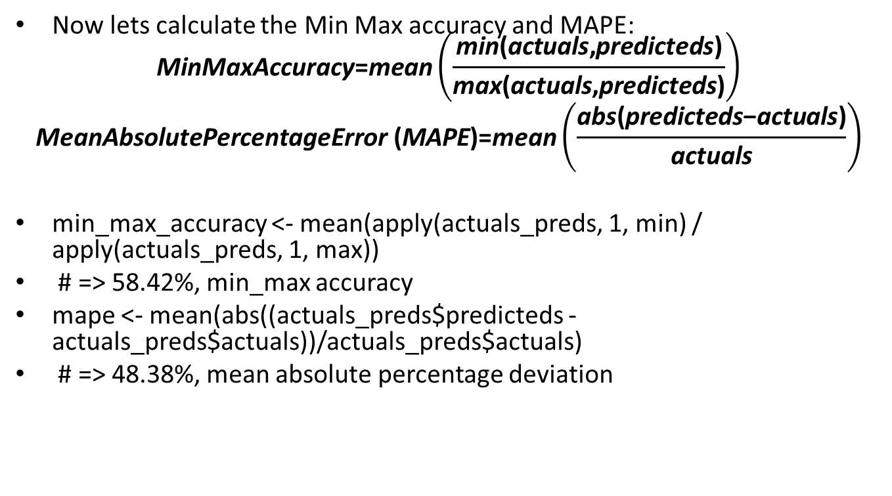
Now lets calculate the Min Max accuracy and MAPE: $\text{MinMaxAccuracy}\text{=}\text{mean}\left(\frac{\text{min}\text{(}\text{actuals}\text{,}\text{predicteds}\text{)}}{\text{max}\text{(}\text{actuals}\text{,}\text{predicteds}\text{)}}\right)$
$$\text{MeanAbsolutePercentageError}\text{ (}\text{MAPE}\text{)=}\text{mean}\left(\frac{\text{abs}\text{(}\text{predicteds}\text{−}\text{actuals}\text{)}}{\text{actuals}}\right)$$
min_max_accuracy <- mean(apply(actuals_preds, 1, min) / apply(actuals_preds, 1, max))
# => 58.42%, min_max accuracy
mape <- mean(abs((actuals_preds$predicteds - actuals_preds$actuals))/actuals_preds$actuals)
# => 48.38%, mean absolute percentage deviation

Slide 66
k- Fold Cross validation
Suppose, the model predicts satisfactorily on the 20% split (test data), is that enough to believe that your model will perform equally well all the time? It is important to rigorously test the model’s performance as much as possible. One way is to ensure that the model equation you have will perform well, when it is ‘built’ on a different subset of training data and predicted on the remaining data.
How to do this is? Split your data into ‘k’ mutually exclusive random sample portions. Keeping each portion as test data, we build the model on the remaining (k-1 portion) data and calculate the mean squared error of the predictions. This is done for each of the ‘k’ random sample portions. Then finally, the average of these mean squared errors (for ‘k’ portions) is computed. We can use this metric to compare different linear models.
By doing this, we need to check two things:
If the model’s prediction accuracy isn’t varying too much for any one particular sample, and
If the lines of best fit don’t vary too much with respect the the slope and level.
In other words, they should be parallel and as close to each other as possible. You can find a more detailed explanation for interpreting the cross validation charts when you learn about advanced linear model building.

Slide 67
library(DAAG)
cvResults <- suppressWarnings(CVlm(df=cars, form.lm=dist ~ speed, m=5, dots=FALSE, seed=29, legend.pos="topleft", printit=FALSE, main="Small symbols are predicted values while bigger ones are actuals."));
# performs the CV
attr(cvResults, 'ms') # => 251.2783 mean squared error

Slide 68
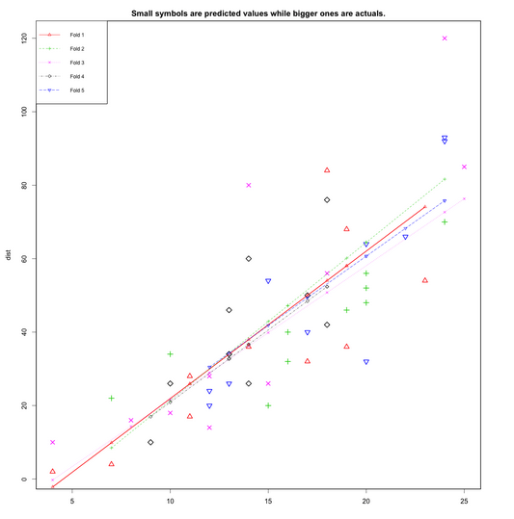
In the below plot, Are the dashed lines parallel? Are the small and big symbols are not over dispersed for one particular color?

Slide 69
Question
?

